Slide 1
Rock Type | Mass | Volume | Density (w/v)

Slide 2
DO NOW
Glaucous is the name for a colour. Write a description for what you think this colour looks like.

Slide 3

Notes:
Glaucous was first used as a color name in 1671, but it's more than a hue. It describes the powdery—and perfectly harmless—blue-gray or blue-green coating on grapes and plums.

Slide 4
I know what sedimentary rocks are and how they form
I know the main properties of sedimentary rocks

Slide 5
We use physical __________ to help identify minerals.
______ is the colour of a powdered mineral
______ describes how light interacts with the surface of the mineral
________ or ________ describes how a mineral breaks
______ is a useful way to identify some minerals, but can unreliable
Notes:
Glaucas
Lustre
Fracture and Cleavage
Colour

Slide 6
____ ________ _____ allows us to compare the hardness of minerals.
Hardness | Mineral
1
2
3
4
5
6
7
8
9
10
Talc
Gypsum
Calcite
Fluorite
Apatite
Orthoclase
Quartz
Topaz
Corundum
Diamond

Slide 7
The appearance of an igneous rock is determined by:
How fast or slow it _____
Which ________ make it up
Notes:
solidifies/crystalises
mineral

Slide 8
Cooling rate determines the ____ of the crystals:
Extrusive igneous rocks have _____crystals
Intrusive igneous rocks have _____ crystals
Notes:
size
small or no
large

Slide 9
The type of minerals it contains determines the colour it will be:
Felsic igneous rocks are _____ coloured
Mafic igneous rocks are ____ coloured
Notes:
Light
Dark

Slide 10
Mineral
A naturally occurring solid substance with a definite chemical composition.
Notes:
Inorganic = not from living

Slide 11
Study Video

Slide 12
Sedimentary
Formed from sediment deposited by water or air
Notes:
Inorganic = not from living

Slide 13
Sediment
Matter that settles to the bottom of a liquid
Notes:
Inorganic = not from living

Slide 14
Clast
Clast = grain
Grain = clast

Slide 15
Compacted
Compacted = compressed
Compressed = compacted

Slide 16
Bed
Bed = layer
Layer = bed

Slide 17
Strata
Strata = layer
Layer = strata

Slide 18
Property
Property = characteristic
Characteristic = property

Slide 19
I know what sedimentary rocks are and how they form
I know the main properties of sedimentary rocks
Making the connection
The properties of sedimentary rocks allow us to identify them, and understanding their properties helps us to figure out how they formed.
Rocks are made of minerals
All rocks are found in the lithosphere, which is the outside layer of the Earth
Property – Characteristic
Mineral - A naturally occurring solid substance with a definite chemical composition.

Slide 20
Learning Criteria
SWBAT describe how are sedimentary rocks formed?
List 4 geological processes that contribute to weathering of rocks
Define compaction
Define cementation

Slide 21
I know what sedimentary rocks are and how they form
I know the main properties of sedimentary rocks
What is are sedimentary rocks?
Property – Characteristic
Sediment – Material that settles to the bottom of a liquid
Sedimentary rocks are formed from materials deposited as sediment and consolidated by pressure.

Slide 22
I know what sedimentary rocks are and how they form
I know the main properties of sedimentary rocks
How are sediments transported?
Give an example of an environment where sediments are transported.
Sediments are eroded and transported by wind, running water, the sea, or glaciers.
Property – Characteristic
Sediment – Material that settles to the bottom of a liquid

Slide 23
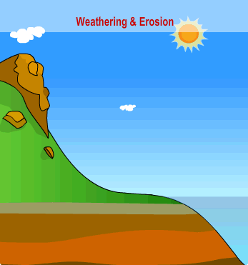

Slide 28


Slide 29
I know what sedimentary rocks are and how they form
I know the main properties of sedimentary rocks
What are sedimentary rocks made of?
Sedimentary rocks are made of clasts, which are compacted and cemented together.
Property – Characteristic
Sediment – Material that settles to the bottom of a liquid
Clasts = grains
Compacted = compressed

Slide 30
I know what sedimentary rocks are and how they form
I know the main properties of sedimentary rocks
What are the layers in sedimentary rocks called?
The layers that make up sedimentary rocks are called beds, or strata.

Slide 31
I know what sedimentary rocks are and how they form
I know the main properties of sedimentary rocks
How are sediments transported?
Give an example of an environment where sediments are transported.
The major identifying properties of sedimentary rocks are:
They have layers
They are made of clasts
They can contain fossils
They are not crystalline (but can contain crystals)
They can preserve features of the environment they were deposited in (eg. mudcracks or ripples)
Property – Characteristic
Sediment – Material that settles to the bottom of a liquid
Clasts = grains
Notes:
The difference between crystalline and containing crystals. Crystalline means the rock formed into crystals as it cooled, contains crystals means the rock formed from sediments, some of those sediments were already formed crystals

Slide 33
I know what sedimentary rocks are and how they form
I know the main properties of sedimentary rocks
How are sediments transported?
Give an example of an environment where sediments are transported.
Compaction and Cementation
The processes by which sediments are changed into rock are complex, but can be simplified into two processes, called compaction and cementation.
Property – Characteristic
Sediment – Material that settles to the bottom of a liquid
Clasts = grains

Slide 34
Cementation
Compaction
Compaction:
happens when sediments are deeply buried, placing them under pressure because of the weight of overlying layers.
This squashes the grains together more tightly.

Slide 35
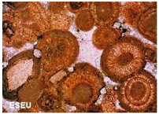
Cementation:
is where new minerals stick the grains together – just as cement (from a bag) binds sand grains in a bricklayer’s mortar.
If you look carefully at the microscope photo, you can see mineral crystals that have grown around the sediment grains and bonded them together.
Cementation
Compaction

Slide 36
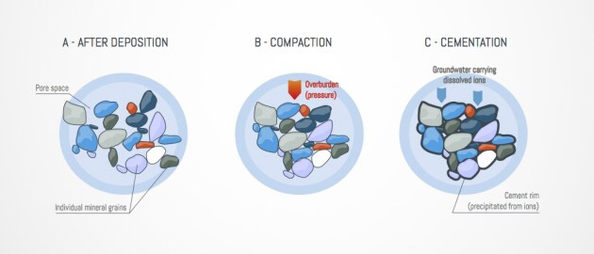

Slide 37
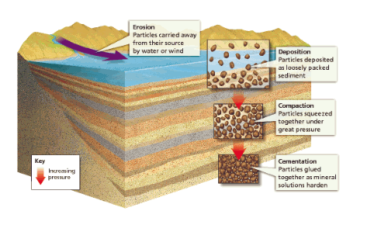
Cementation and Compaction

Slide 38
Sedimentary rocks can also be folded, but the layers are always originally horizontal

Slide 39
WHICH ROCKS ARE THE OLDEST?

Slide 40
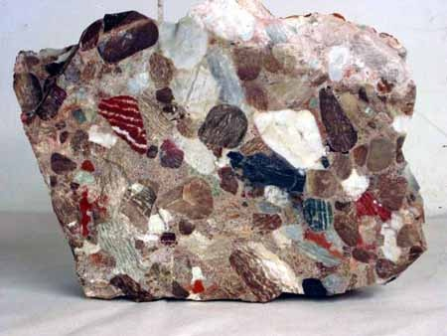

Slide 41
I know what sedimentary rocks are and how they form
I know the main properties of sedimentary rocks
What about the clasts can tell us how sedimentary rocks formed?
The size, shape and type of clasts in a sedimentary rock can tell us more about how they formed. This is also usually how we give them their names.

Slide 43
I know what sedimentary rocks are and how they form
I know the main properties of sedimentary rocks
Why is learning about sedimentary rocks important?
Rocks tell a story – the type of rock tells you what the rock has been through and allows us to draw conclusions about how they formed.

Slide 44
I know what sedimentary rocks are and how they form
I know the main properties of sedimentary rocks

Slide 45

Notes:
2.20 mins

Slide 46
How are sedimentary rocks formed?
List 4 geological processes that contribute to weathering of rocks
Define compaction
Define cementation
What are Clastic rocks?
Give examples

Slide 48
Wash your hands

Slide 49
Create your own
Sedimentary Lolly Rock

Slide 50
First, wash your hands
Then put your name on your lolly cake paper patty
You will be handed lollies that you must cut up.
Cutting the lollies is simulating what process?
Your lollies must be laid down in layers.
Your layers are know as what?
After EACH layer you must pour a spoonful of liquid chocolate over the layer
What does the liquid chocolate represent?
Any questions
Notes:
Weathering and erosion
Strata or beds
Cementation

